Slide 1
Autodesk Vault Professional Numbering Schemes | Numbering Providers
Markus Koechl
Solutions Engineer PDM|PLM – Autodesk Central Europe

Slide 2
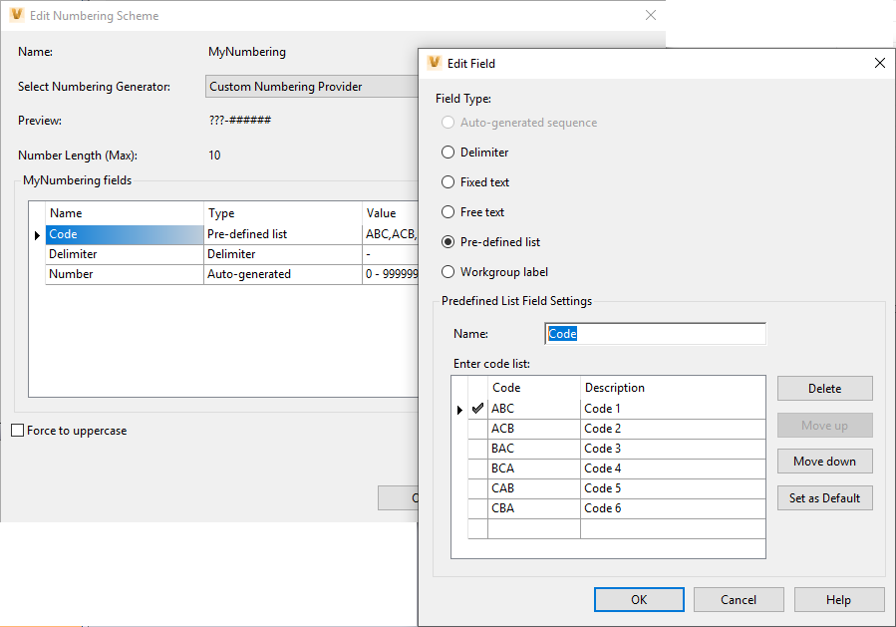
Numbering Schemes | Overview
Configuration
Configure one to many schemes for
Files | Items | ECOs
For Vault Data Standard also for
Folders | Projects | Custom Objects
Schemes must contain one
Auto-generated sequence
Schemes may contain one to many
Fixed text | Free text | Predefined List
One Workgroup Label – Site Index for multi-site environments

Slide 3
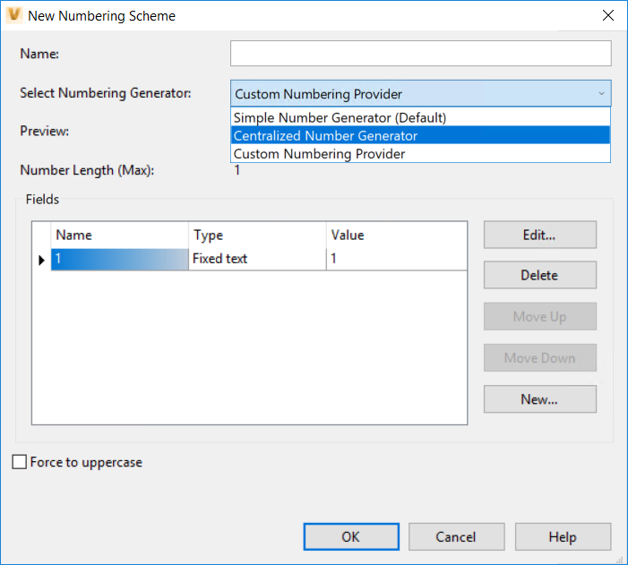
Options for Number Generators
Introduction
Simple Number Generator generates a number from the corresponding workgroup you are logged in within a replicate environment
Centralized Number Generator generates numbers from the publisher whether you are connected to a publisher or a workgroup
Create your own custom number generator based on rules and mechanism outside the Vault business logic and integrate into the Vault Numbering scheme
Notes:
Numbering Schemes let you configure how files, items, and change orders are named when they are added to a Vault. Vault 2020 introduces a new capability to introduce a numbering scheme provider User-Defined Number Generator. This will allow you to create you own provider based on rules in your company or derived from other business systems.
The following enhancements have been made to the numbering scheme:
For replication environment the Simple number Generator will continue to generate a number from the corresponding workgroup you are logged in as it was before while the Centralized Number Generator will always generate numbers from the publisher whether I log into the publisher or a workgroup.
There is a new capability to introduce a numbering scheme provider User-Defined Number Generator. This enables you to create you own provider based on rules in your company or derived from other business systems. You also have an option to select Centralized Number Generator for replication environment.

Slide 4
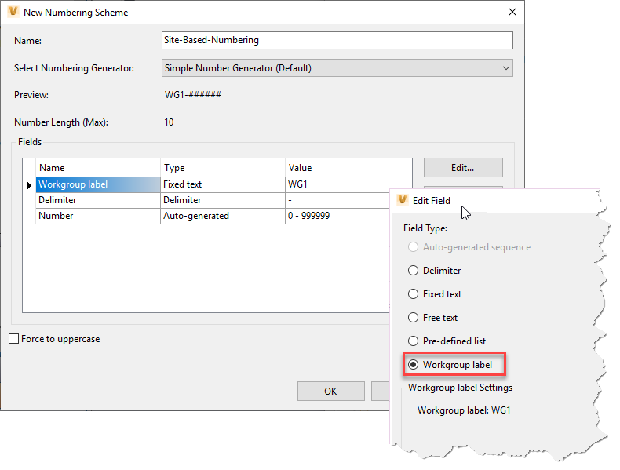
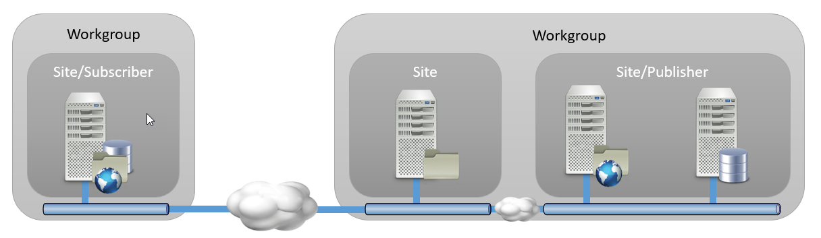
Number Generators | Simple
Default 2020 – As known from 2019, 2018, …
Numbering per Workgroup
Requires workgroup label to avoid conflicts
01-000001
01-000002
01-000003
01-…..
02-000001
02-000002
02-000003
02-…..

Slide 5
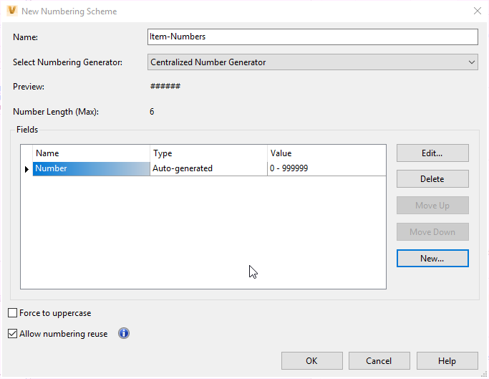
Number Generators | Centralized
NEW Option for Workgroup Replicated Environments
Numbering across all Workgroups
Publisher shares number
000001
000002
…
…
000005
…
…
…
000003
000004
…
000006

Slide 6

Number Generators | Custom Numbering
NEW Option for Single Server and Replicated Environments
Plug-In Custom Numbering on ADMS
Retrieve numbers based on custom biz logic or 3rd party provider
ABC-000001
CBA-000002
…
…
BAC-000005
…
…
…
ABC-000003
CBA-000004
…
ABC-000006

Slide 7
Custom Numbering Provider “MyNumbering” - Sample

Slide 8
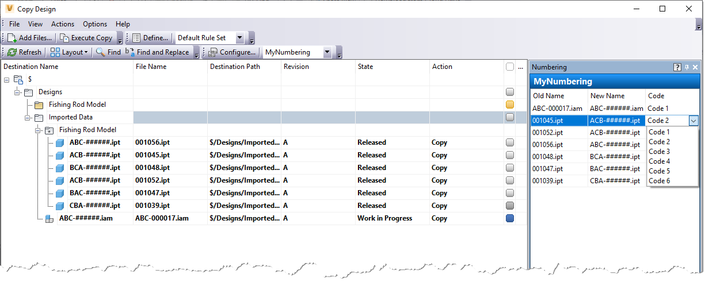
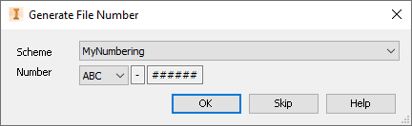
MyNumbering | Sample
Combine User Input and Unique Sequential Number
No change for users
Select from list…
… and get unique sequential number
ADMS Plug-In
ABC-000001
CBA-000002
…
…
BAC-000005
…

Slide 9
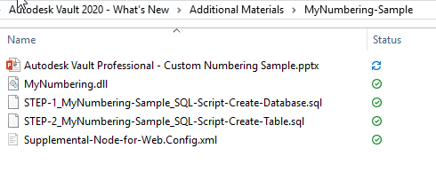
MyNumbering | Sample
Deliverables
SQL Scripts
Create Database
Create Table
ADMS Server Extension
Custom Number Provider “MyNumbering.dll”
Template to register Extension

Slide 10
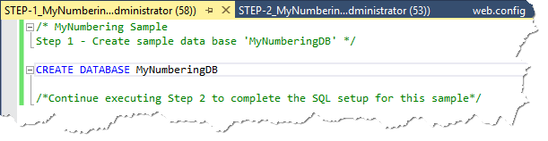
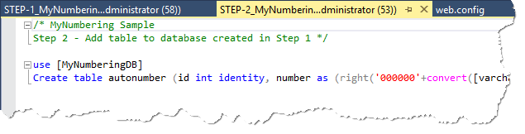
MyNumbering | Sample
Installation Instructions – Autodesk Data Management Server
Pre-requisites
Single Server for
SQL | ADMS
SQL Management Studio
Execute Script Step-1
Execute Script Step-2

Slide 11
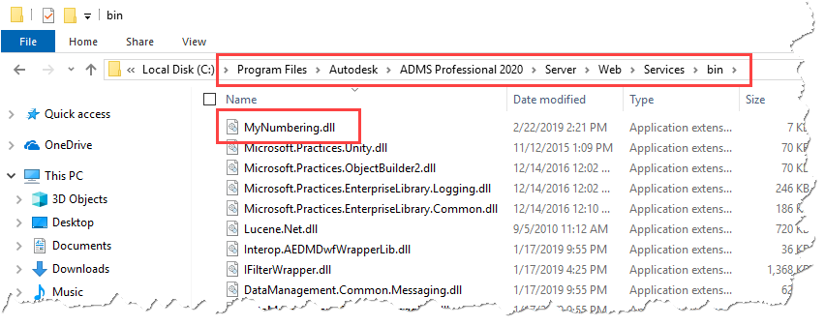
MyNumbering | Sample
Installation Instructions – Autodesk Data Management Server
Step 2
Copy “MyNumbering.dll” to ADMS Server

Slide 12
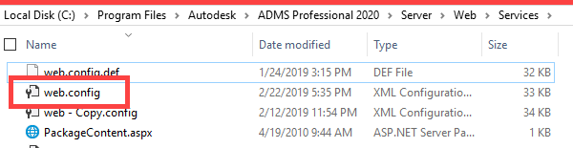
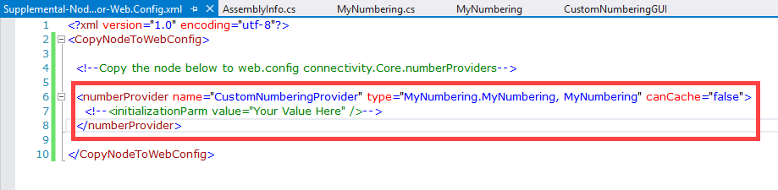
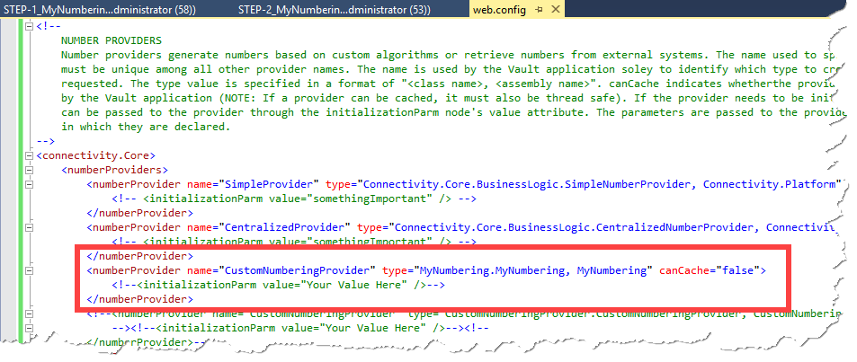
MyNumbering | Sample
Installation Instructions – Autodesk Data Management Server
Step 3
Copy xml node from source “Supplemental-Node…” to web.config

Slide 13

MyNumbering | Sample
Installation Instructions – Autodesk Data Management Server
Step 4
Restart Internet Information Service
IIS Reset

Slide 14
MyNumbering | Sample
Installation Instructions – Autodesk Vault Explorer
Step 5
Define Numbering Scheme
Name = your choice
Generator = Custom Numbering Provider
Requirements
1. Element = Fixed Text or Free Text or Predefined List
2. Element = Delimiter
3. Element = Auto-generated sequence, 6 digits

Slide 15
MyNumbering | Sample
Start Using it…
Select from list…
… and get unique sequential number
ADMS Plug-In
ABC-000001
CBA-000002
…
…
BAC-000005
…

